Slide 1

MSBD 5013 Project 2: M5 Forecasting Accuracy & Uncertainty
CHENG, Pak Hei (20795962) LO, Ngai Hung(20787771)
Presentation video link: https://youtu.be/UH0I578_0bA

Slide 2
Introduction
The challenge requires participants to predict Walmart sales in particular US stores for the next 28 days, the prediction uncertainty is also required to be reported.
We will construct various rolling statistical features, categorical features that reflect the hierarchical information of the time series, as well as integrating some external data.
We will train a baseline model using linear regression and compare subsequent models with it.

Slide 3
Data Analysis and feature engineering

Slide 4

Provided Dataset
There are 4 CSV files provided for the challenge.
"sales_train_validation.csv" & "sales_train_evaluation.csv" Provide the historical daily (totally 1941 days) sales data on each product and store.
"calendar.csv". Provide details information on the date. (e.g. weekday & event)
"sell_prices.csv" Provide the price of each product sold in each store.

Slide 5
Dataset information
30490 time series to predict, one for each item
The time series contain information of item hierarchies
Item category, department, store and state sold at
Example: FOOD_1_001_CA_1
1941 days of sales available for each time series, with some items’ sales padded to fill the total number of days

Slide 6
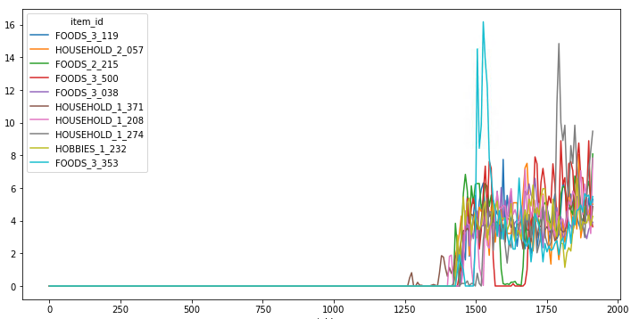
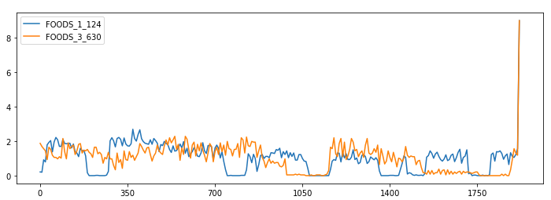
Time series clustering
To construct features, we need to know what the time series look like. Unfortunately, 30k is too many to analyze
We referenced TamirBennatan[1] time series clustering analysis to group similar series together. From there, we build features based on insights from each groupings

Slide 7
Feature Engineering
Intuitively speaking, most time series are autoregressive in some sense. Therefore, our first instinct is to construct auto-regressive features such as
Rolling sales average/std in the past 3, 7, 30, 90, 180, and 360 days
How many consecutive days had the product had no sales
We also took the difference between long-short term rolling averages to reflect change in sales trend
To encourage our model to learn seasonal patterns, we used cyclic features such as weekday, week number and month as part of our feature
Categorical variables are encoded either with global mean or as nominal variables
Additionally, events are shifted forward for the model to anticipate possible change of sales trend. E.g. predicting 28 days forward -> event type at 2011-11-27 is Christmas day

Slide 8
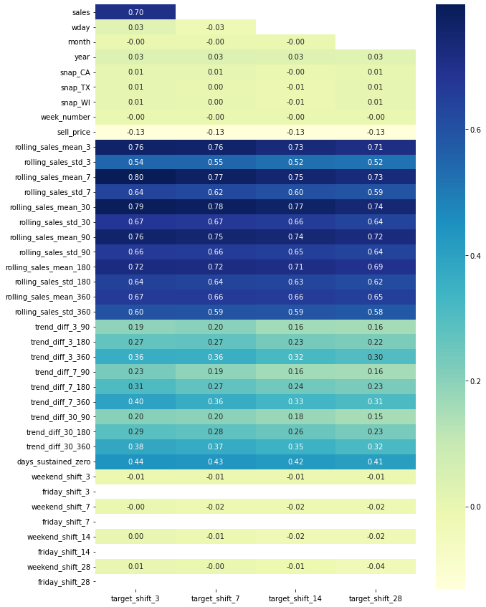
Aggregated correlation with target
As expected, the most prominent features are the autoregressive features, such as “rolling_sales_mean_3”
It’s also interesting that the current “sell_price” has a week negative correlation with the sales
The trend change variables seems to have less effect on the future target sales
Note that individual time series correlation will be different from aggregated ones

Slide 9
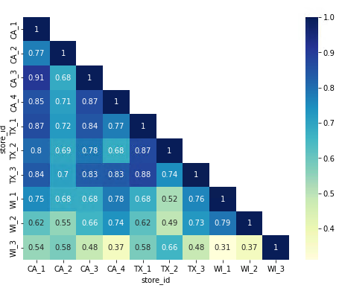
Within level sales correlations
We also explore the correlations between sales time series in the same level. E.g store-wise sales correlation
Here we give an example of correlation plot for store-wise sales
Notes:
This correlation plot motivates us to consider single model that encapsulate all hierarchical levels instead of one model per level

Slide 10
Accuracy

Slide 11
Goals
The goal of accuracy subtask is to provide a method to forecast items sales in the next 28days with high accuracy
Sale from day 1942 to 1969
Error between the predicted sales and ground truth is used to measure how accurate is the prediction
Weighted Root Mean Squared Scaled Error (RMSSE) is used for evaluation in Kaggle

Slide 12
Selected Model
Baseline model: Linear Regression
Final model: LightGBM
Suitable to handle mixed data type
Parameter*:
'num_leaves': 100
'max_depth': 9
'learning_rate': 0.03
'reg_alpha': 0.2
'reg_lambda': 0.2
‘num_boost_round’: 300
‘early_stopping_rounds’: 100
*Only shows part of the parameter. May refer to the code for more details

Slide 13
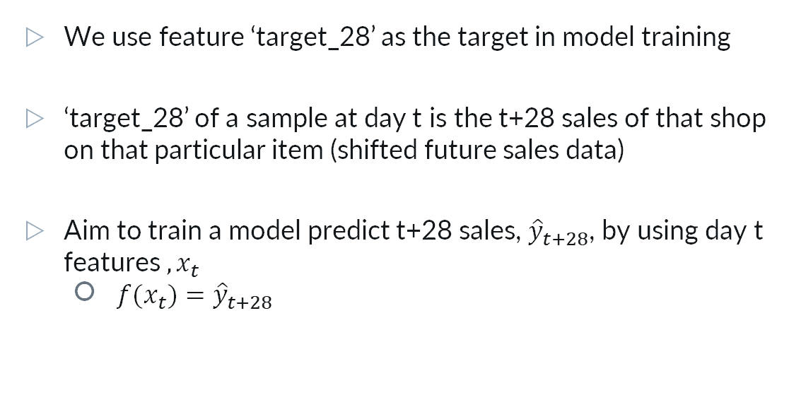
Target shifting Method
We use feature ‘target_28’ as the target in model training
‘target_28’ of a sample at day t is the t+28 sales of that shop on that particular item (shifted future sales data)
Aim to train a model predict t+28 sales, ${\hat{y}}_{t+28}$, by using day t features $,x_{t}$
${f(x}_{t})={\hat{y}}_{t+28}$

Slide 14
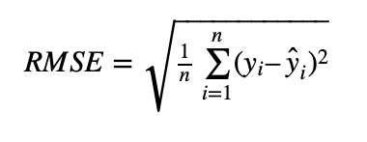
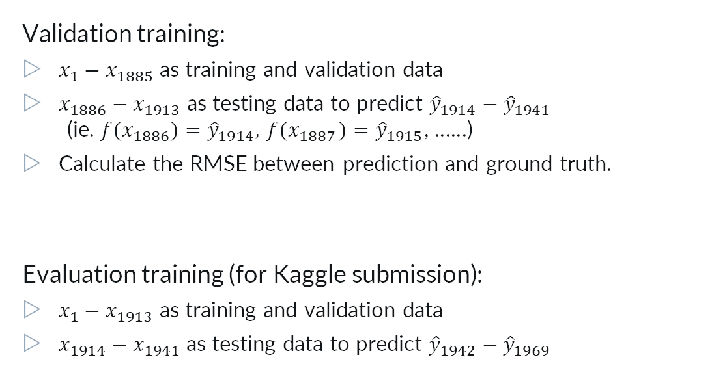
Training Method
Validation training:
$x_{1}−x_{1885}$ as training and validation data
$x_{1886}−x_{1913}$ as testing data to predict ${\hat{y}}_{1914}−{\hat{y}}_{1941}$
(ie. ${f(x}_{1886})={\hat{y}}_{1914},{ f(x}_{1887})={\hat{y}}_{1915}$, ……)
Calculate the RMSE between prediction and ground truth.
Evaluation training (for Kaggle submission):
$x_{1}−x_{1913}$ as training and validation data
$x_{1914}−x_{1941}$ as testing data to predict ${\hat{y}}_{1942}−{\hat{y}}_{1969}$

Slide 15
Training Method
To prevent over-fitting, the following measurement is adopted on LightGBM :
ElasticNet regularization
Stratified 3-fold cross-validation to obtain averaging prediction
Considering the running time and hardware limitation, we only choose 3 as the fold number
We also used lookahead windows of 3, 7, 14 and 28 days to train different models for a final ensemble

Slide 16
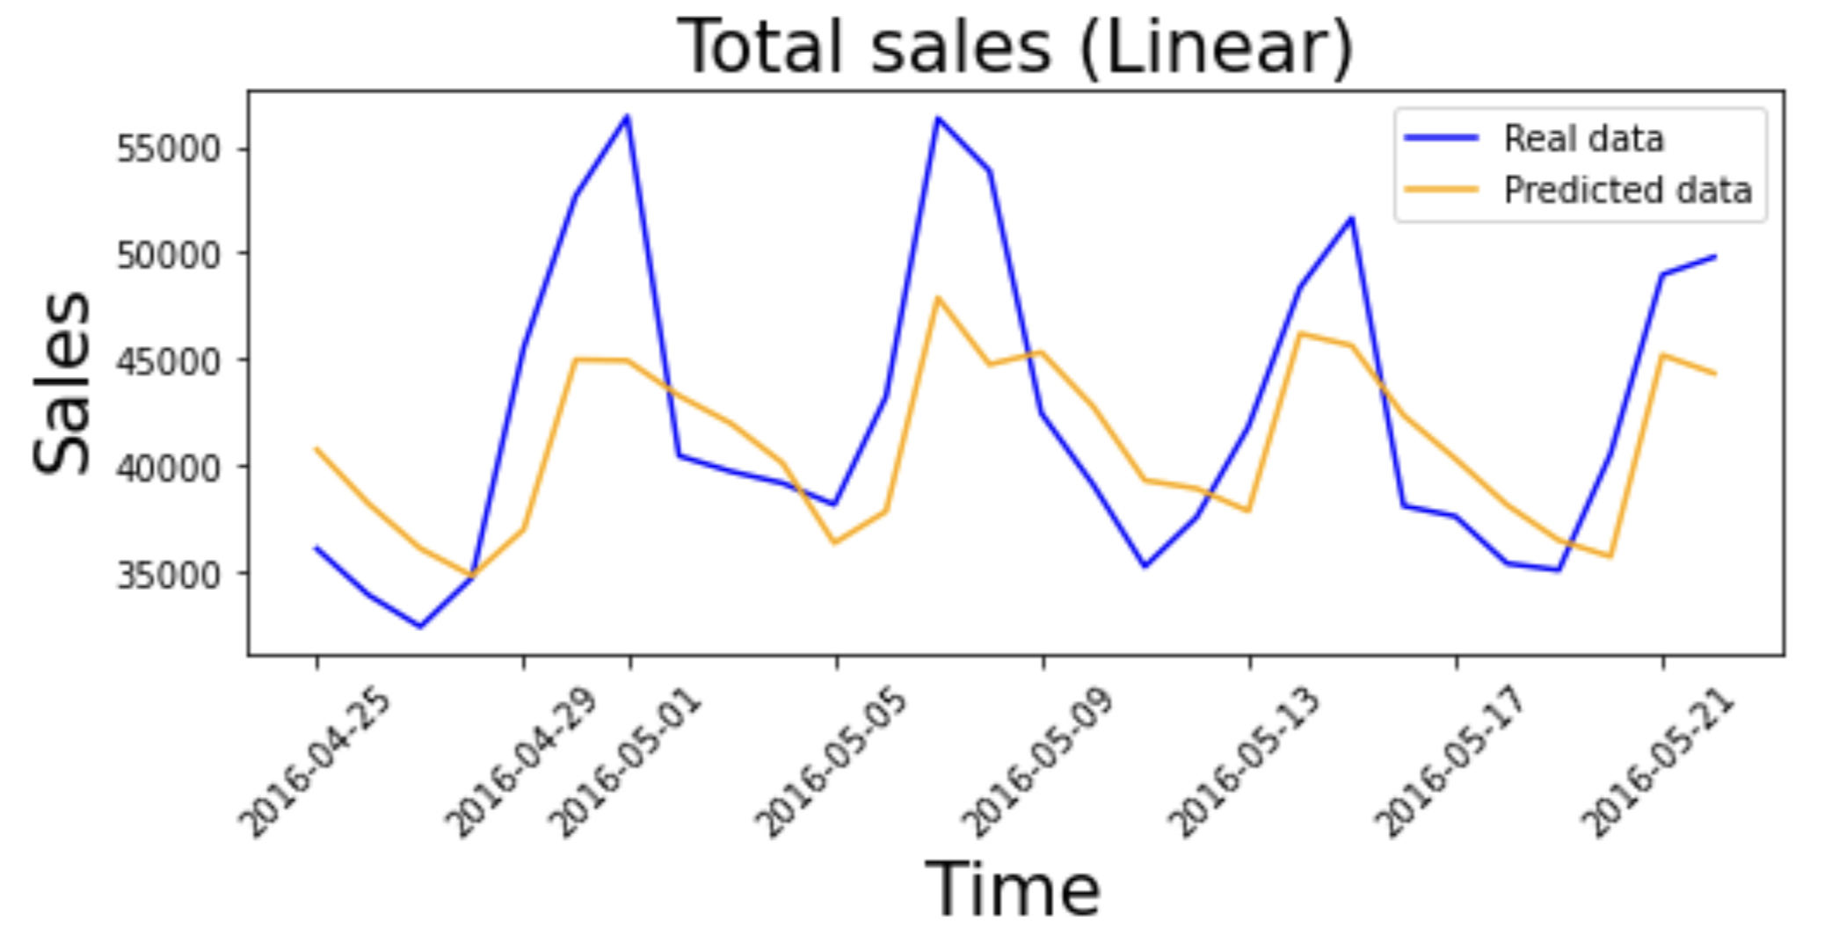
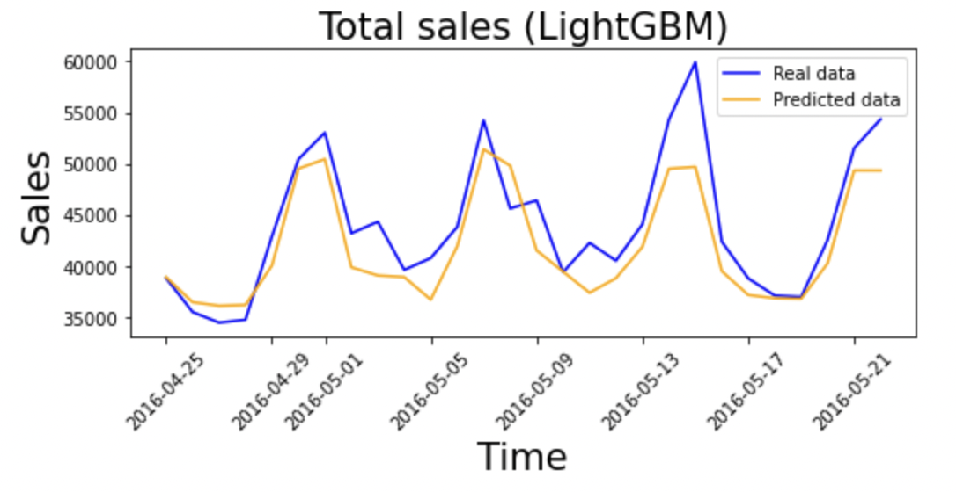
Result
Validation Training result:

Slide 17
Result
Prediction Accuracy:
22% reduction in Kaggle Private RMSSE by using LightGBM
 | Validation RMSE | Kaggle Private RMSSE
Linear Regression | 2.23960 | 0.84297
LightGBM | 2.16752 | 0.65377

Slide 18
Uncertainty

Slide 19
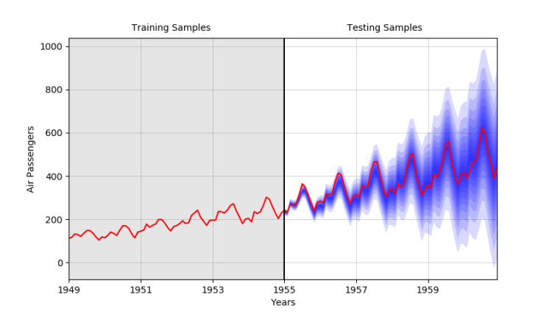
Goals
The goal of uncertainty subtask is to provide the quantiles of a distribution for each point estimate in each time series
The 0.005, 0.025, 0.165, 0.25, 0.50, 0.75, 0.835, 0.975 and 0.995 quantiles are required to be predicted

Slide 20
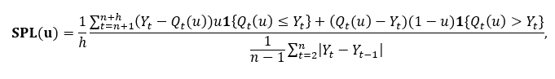
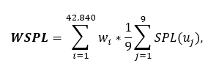
Metric
Scaled Pinball Loss (SPL) is calculated for each time series and quantile
The formula explains how predicted quantiles and the ground truth contribute to the loss
The final metrics is a weighted average of average SPL for each quantiles used, namely
The weights are calculated using the cumulative dollar sales of the last 28 observations in the training samples

Slide 21
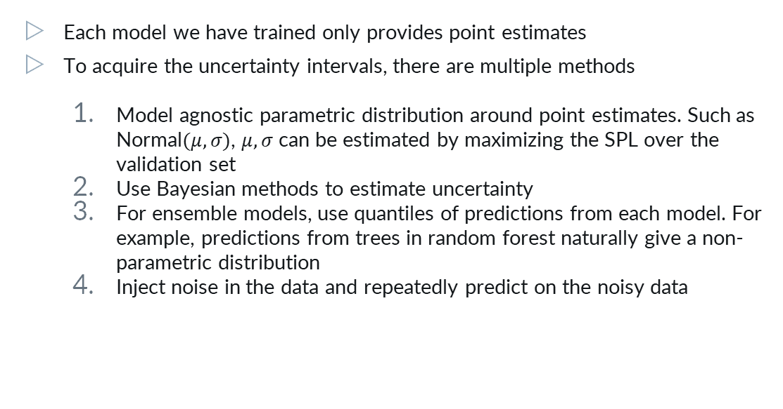
Uncertainty prediction
Each model we have trained only provides point estimates
To acquire the uncertainty intervals, there are multiple methods
Model agnostic parametric distribution around point estimates. Such as Normal$(μ, σ)$, $μ, σ$ can be estimated by maximizing the SPL over the validation set
Use Bayesian methods to estimate uncertainty
For ensemble models, use quantiles of predictions from each model. For example, predictions from trees in random forest naturally give a non-parametric distribution
Inject noise in the data and repeatedly predict on the noisy data

Slide 22
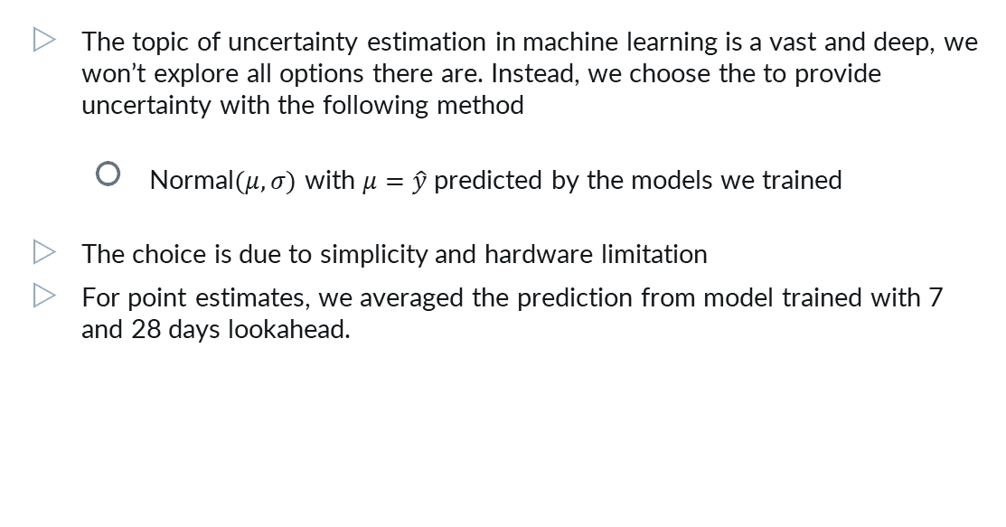
Uncertainty prediction
The topic of uncertainty estimation in machine learning is a vast and deep, we won’t explore all options there are. Instead, we choose the to provide uncertainty with the following method
Normal$(μ, σ)$ with $μ=\hat{y}$ predicted by the models we trained
The choice is due to simplicity and hardware limitation
For point estimates, we averaged the prediction from model trained with 7 and 28 days lookahead.

Slide 23
Result
Prediction Accuracy:
 | Validation RMSE | Kaggle Private WSPL
Bayesian Ridge | 2.28664 | 0.26793
LightGBM | 2.22265 | 0.20878

Slide 24
Ideas for future work

Slide 25
Ideas
Use neural networks such as LSTM to trends in a data-driven manner
Use categorical embeddings to learn a common projection space for better interaction
Use rolling clustering with DTW to capture time dependent trends
Explore the various ways to estimate uncertainty introduced previously

Slide 26
Thanks!
Contribution
CHENG, Pak Hei:
Feature engineering, uncertainty
LO, Ngai Hung:
Feature engineering, accuracy
Notes:
This is the end of our presentation, and we are open for Question and Answering.

